Slide 1






Can machines understand the scientific literature?
Peter Murray-Rust
Dept of Chemistry, Univ of Cambridge
Shweata N Hegde and Ambreen Hamadani
Nat. Inst. For Plant Genome Res. (IN)
MPhil Computational Biology, 2020, Cambridge, UK, 2020-11-11
pm286@cam.ac.uk
peter@contentmine.org
Images from ContentMine CC BY and Wikimedia CC BY-SA

Slide 2
Semantic ContentMining
Knowledge generation for Global Challenges (PMR)
Semantic structure of a scientific paper (PMR)
Wikidata (PMR)
Building a textmining community and our tools (SH)
What we found (AH, Jupyter Notebook)
Image mining (PMR)
Ethical and political (PMR)

Slide 3

Global Crises: UN Sustainable Development Goals
Hunger
Health
Climate
https://sdgs.un.org/goals

Slide 4
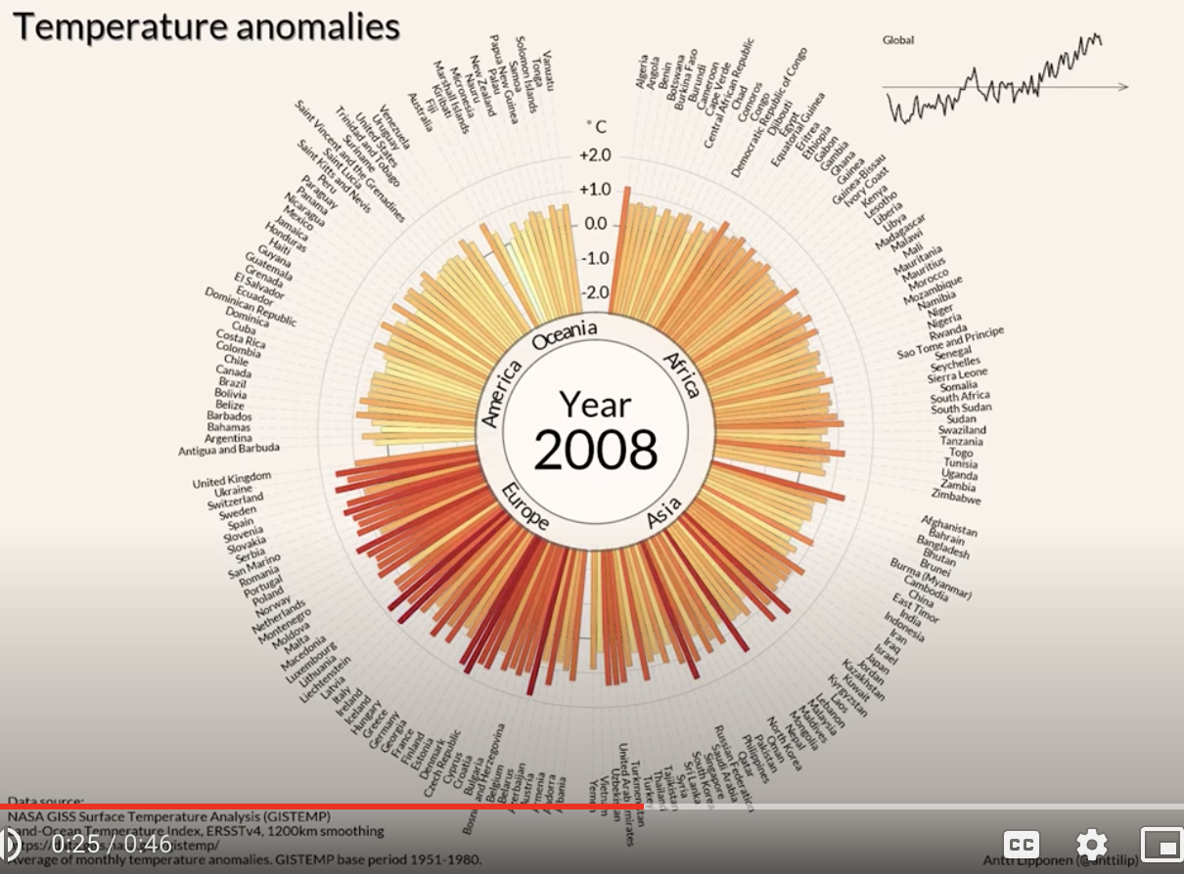
climate
Data that cannot be ignored
Antti Lipponen (@anttilip) of the Finnish Meteorological Institute based on GISTEMP data (CC BY 2.0).
https://twitter.com/dwallacewells/status/1312121745927598080/photo/1
Click this,
it’s terrifying =>
https://www.youtube.com/watch?v=-yIHxOui9nQ&ab_channel=CarbonBrief

Slide 5
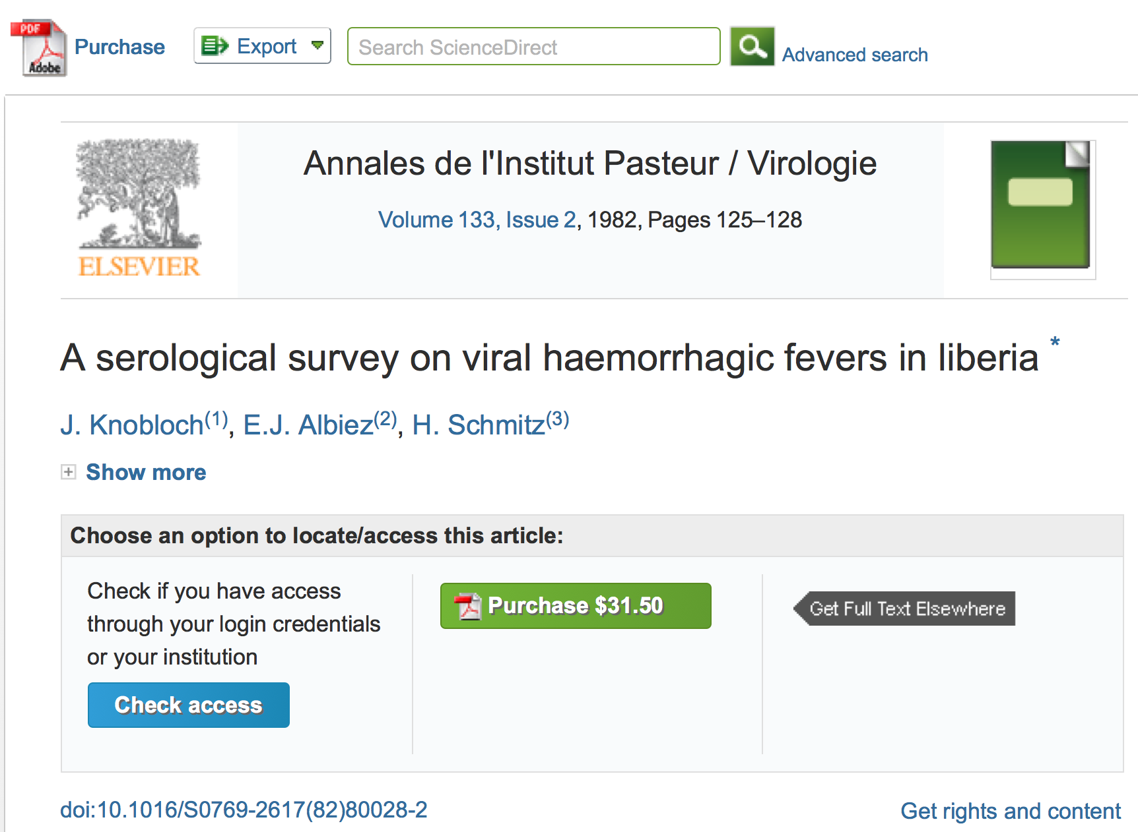
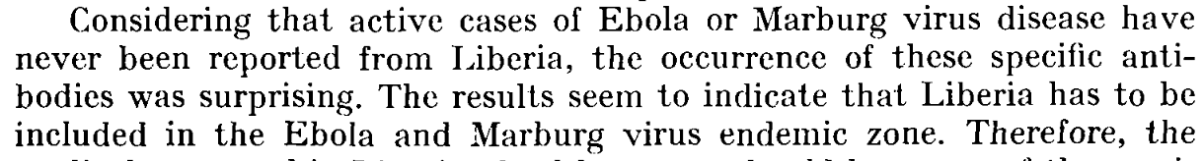
epidemics
Country
Virus

Slide 6
A System Failure of Scholarly Publishing
http://www.nytimes.com/2015/04/08/opinion/yes-we-were-warned-about-ebola.html
We were stunned recently when we stumbled across an article by European researchers in Annals of Virology [1982]: “The results seem to indicate that Liberia has to be included in the Ebola virus endemic zone.” In the future, the authors asserted, “medical personnel in Liberian health centers should be aware of the possibility that they may come across active cases and thus be prepared to avoid nosocomial epidemics,” referring to hospital-acquired infection.
Bernice Dahn (chief medical officer of Liberia’s Ministry of Health)
Vera Mussah (director of county health services)
Cameron Nutt (Ebola response adviser to Partners in Health)

Slide 7

Scholarly publishing is “Big Data”
1 year’s scholarly output!
$500 Billion public research => 2.5 million articles /year , 7000 /day
Most is not Publicly readable and much is unused
ContentMining (TDM) can liberate knowledge
Many mega-publishers fight ContentMining
[1] http://www.crossref.org/01company/crossref_indicators.html
[2] https://en.wikipedia.org/wiki/Mont_Blanc#/media/File:Mont_Blanc_depuis_Valmorel.jpg

Slide 8
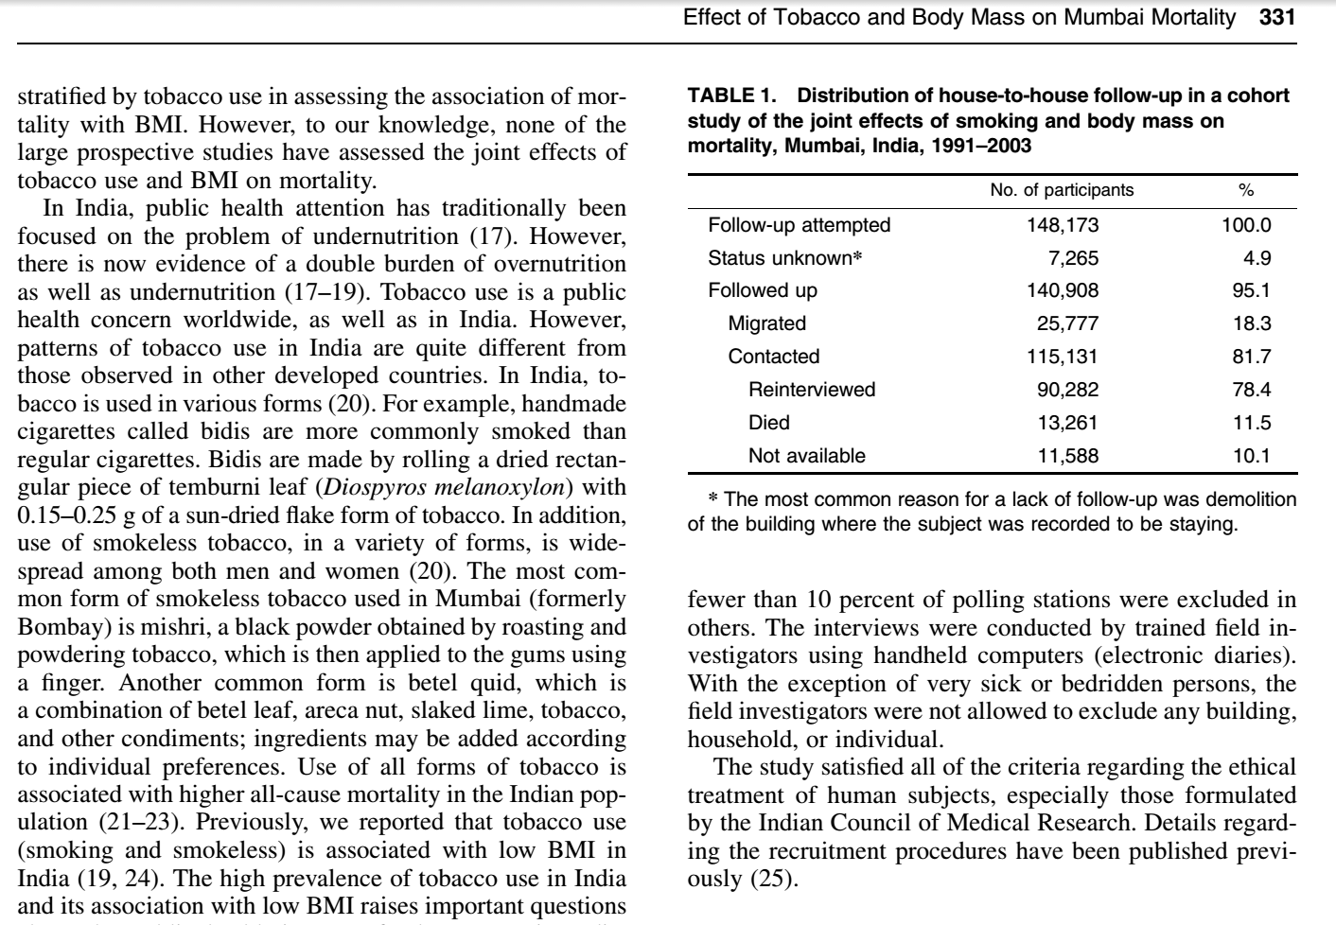
Systematic Reviews
Ellie: “there were 10,000 abstracts and due
to time pressures, we split this between 6 researchers. It took about 2-3 days of work (working only on this) to get through
~1,600 papers each. So, at a minimum this
equates to 12 days of full-time work (and would normally be done over several weeks under normal time pressures).”
Inst Public Health, University of Cambridge
(our) software can filter this in a few minutes

Slide 9
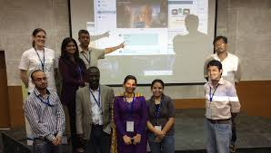
Jenny Molloy
Gita Yadav + colleagues
Delhi 2014
PMR “met” Gita Yadav for a virtual mini-workshop on text-mining for science…
… starting a 5-year collaboration on Plant Sciences, at NIPGR
(Nat. Inst. For Plant Genome Research).
Gita was then appointed Cambridge-India Lecturer in Plant Sciences…

Slide 10

TIGR2ESS Workshop 2019 Delhi
hunger
ContentMining for Food Security
We built dictionaries for:
Rice
Millets
Maize
And searched EuropePMC
https://tigr2ess.globalfood.cam.ac.uk/events/workshop-r-genomics-and-data-mining

Slide 11
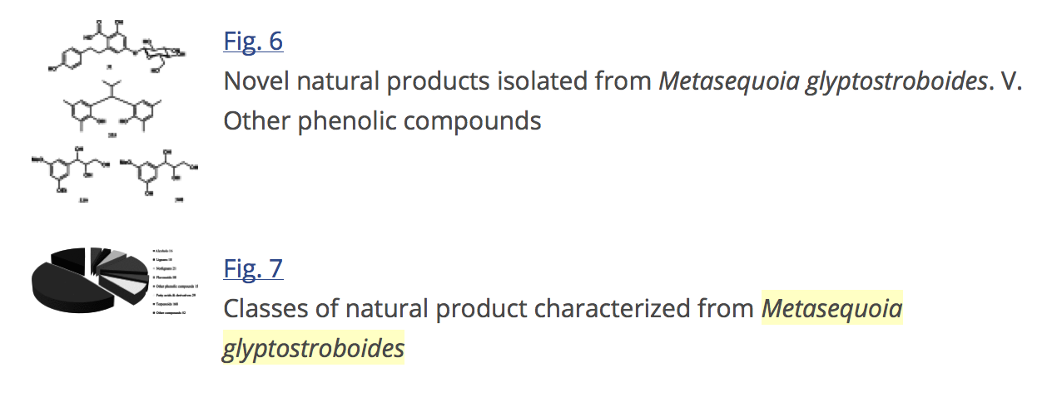
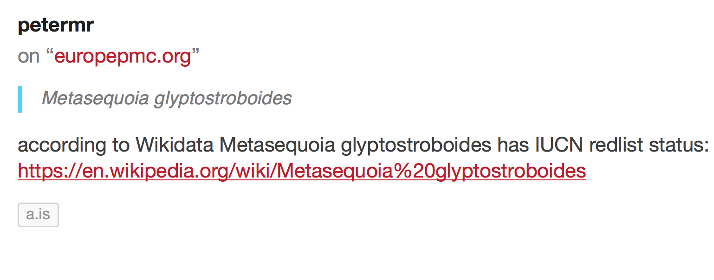
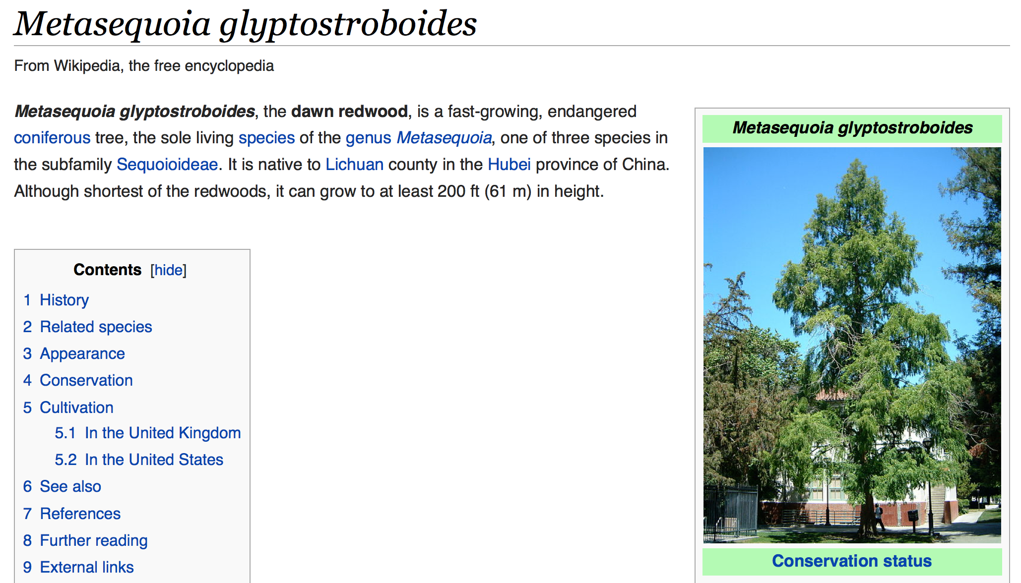
Can machines understand the scientific literature?
Annotated Articles
Symbiont of machines and humans
Hypothes.is markup
of article
amanuens.is

Slide 12

OpenKnowledgeMaps
#DontLeaveItToGoogle
Unsupervised Learning
Or…
...Mendeley
…WebOfScience
…Scopus
… Elsevier
…Springer-Nature
Peter Kraker
An Open Infrastructure is essential
Repositories: BASE , EuropePMC
Free articles: Unpaywall
Preprints: arXiv, bioRxiv, medRxiv
Indexing: Crossref
Scraping: getpapers, quickscrape
Text analysis: OpenKnowledgeMaps, ami
https://elephantinthelab.org/google-and-research-data/

Slide 13
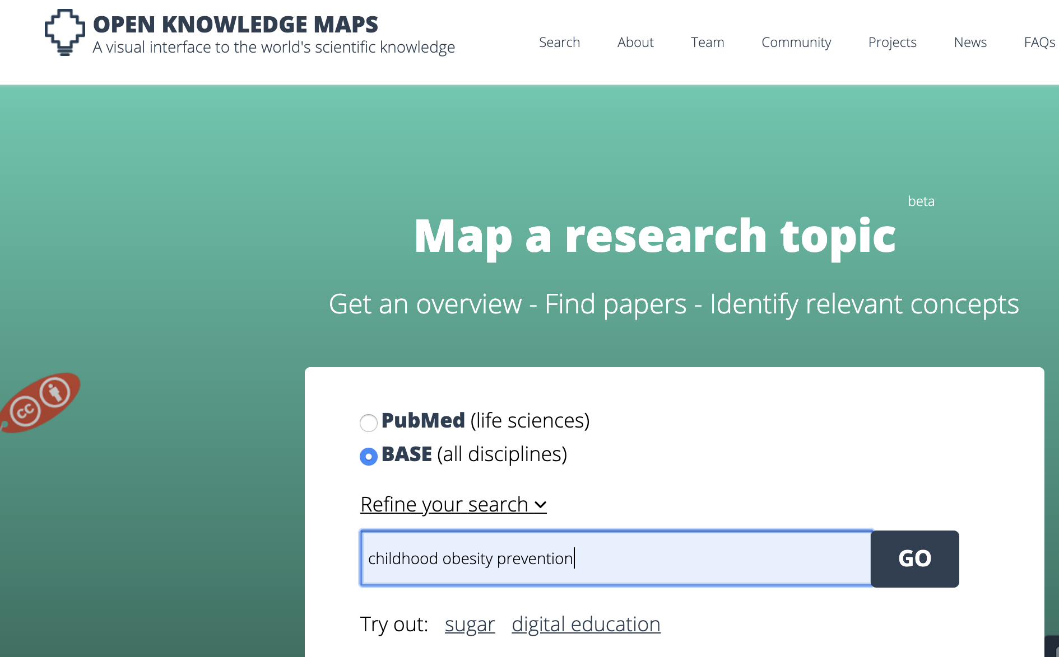
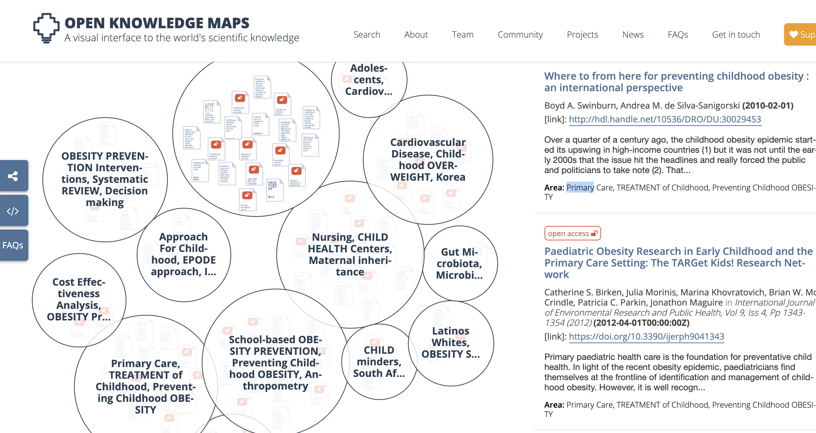
Unsupervised
learning
Unsupervised Learning
Peter Kraker and team
http://openknowledgemaps.org
Let’s ask for “childhood obesity prevention”

Slide 14
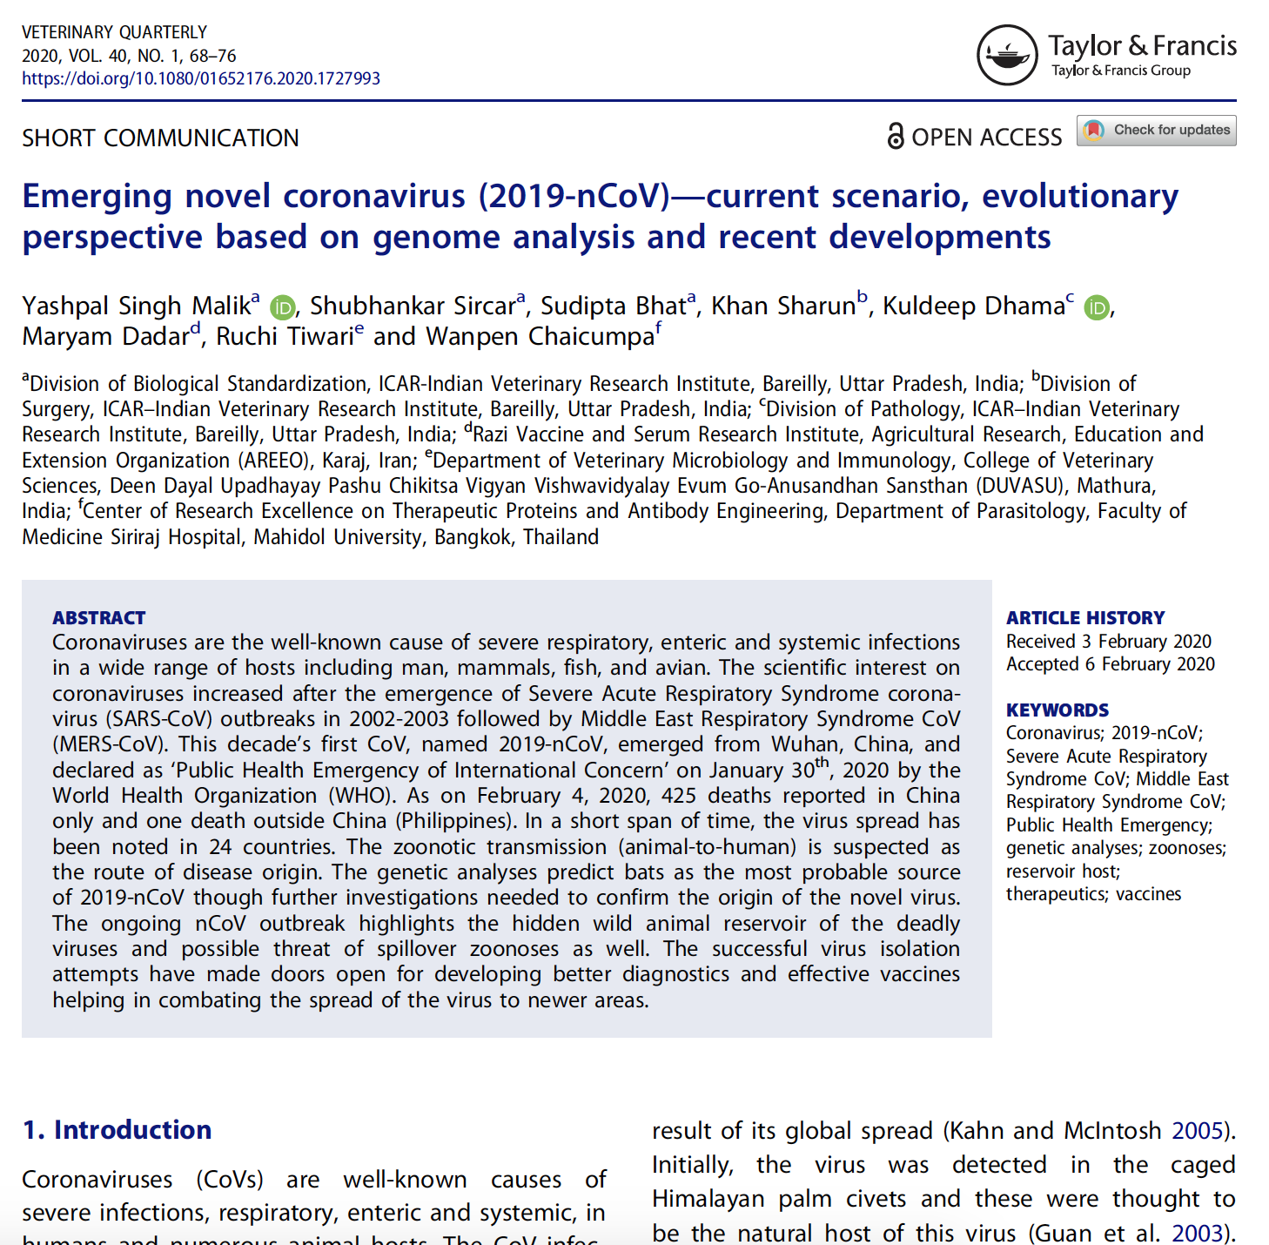
Structure of article
Supervised
Semantic
Facets
Features

Slide 15
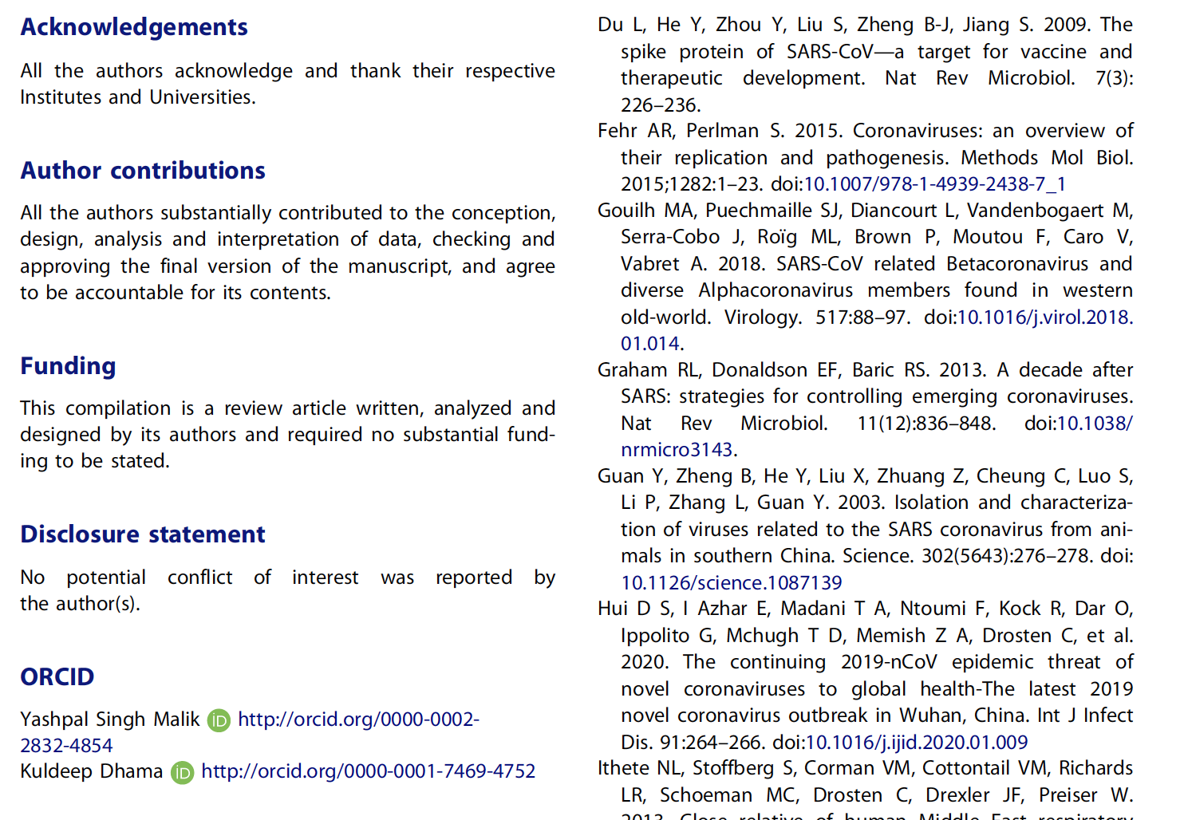
metadata

Slide 16
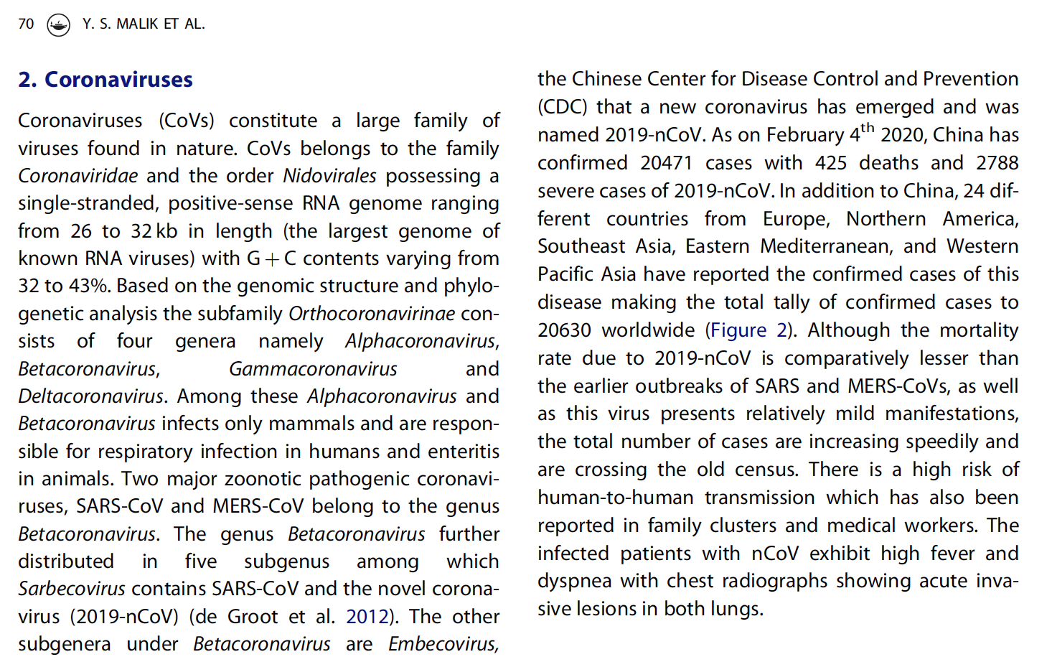
Entities in text
date
virus
country
Nucleic acid
data
genus
disease
role
Med. procedure
symptom
I want to ask: “which countries have SARSC and which have MERS”?
reference
organ

Slide 17
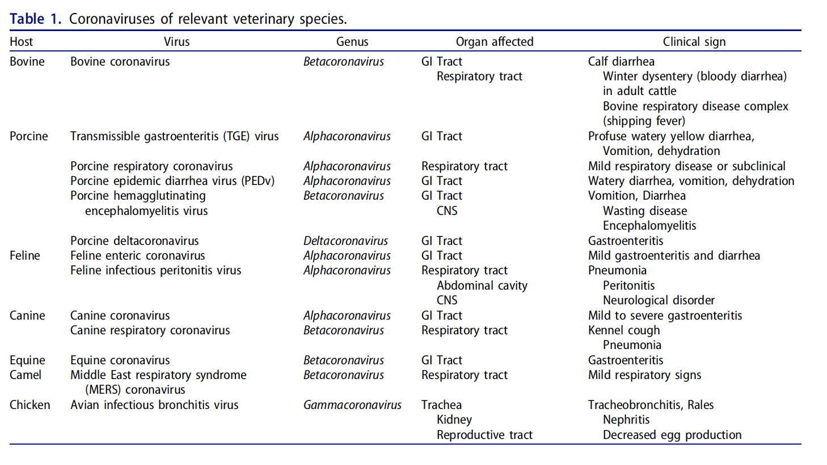
Tables
NO structure in PDF

Slide 18
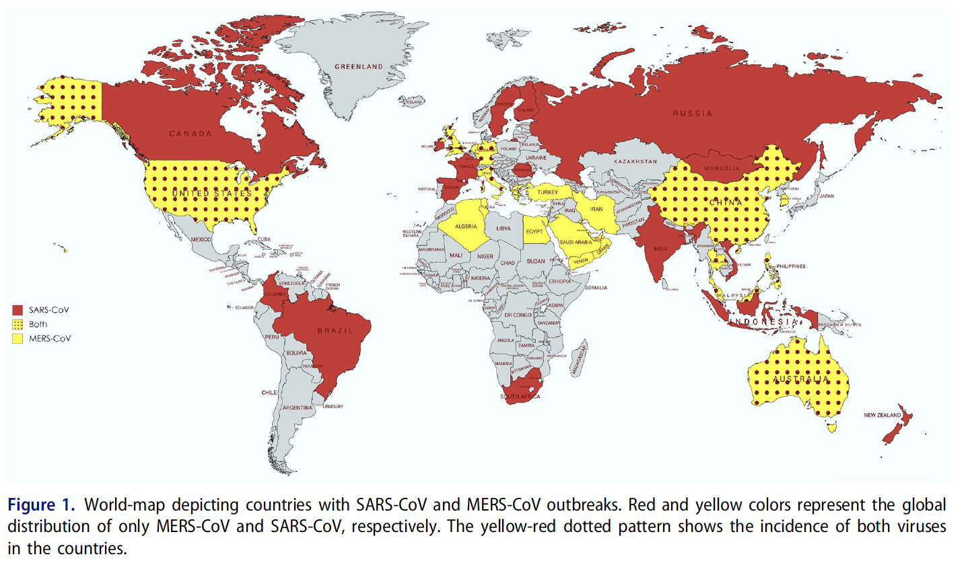
Maps
I want to ask: “which countries have SARS and which have MERS”?

Slide 19
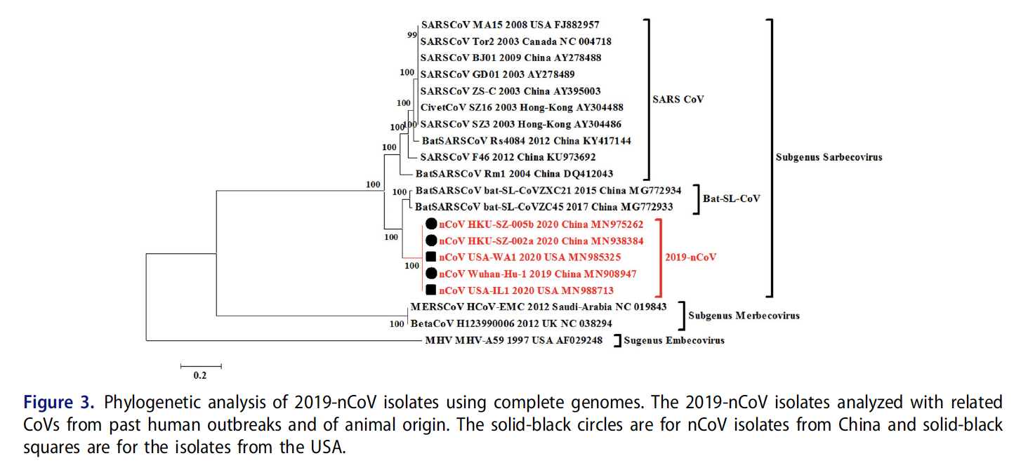
Phylogenetic tree

Slide 20
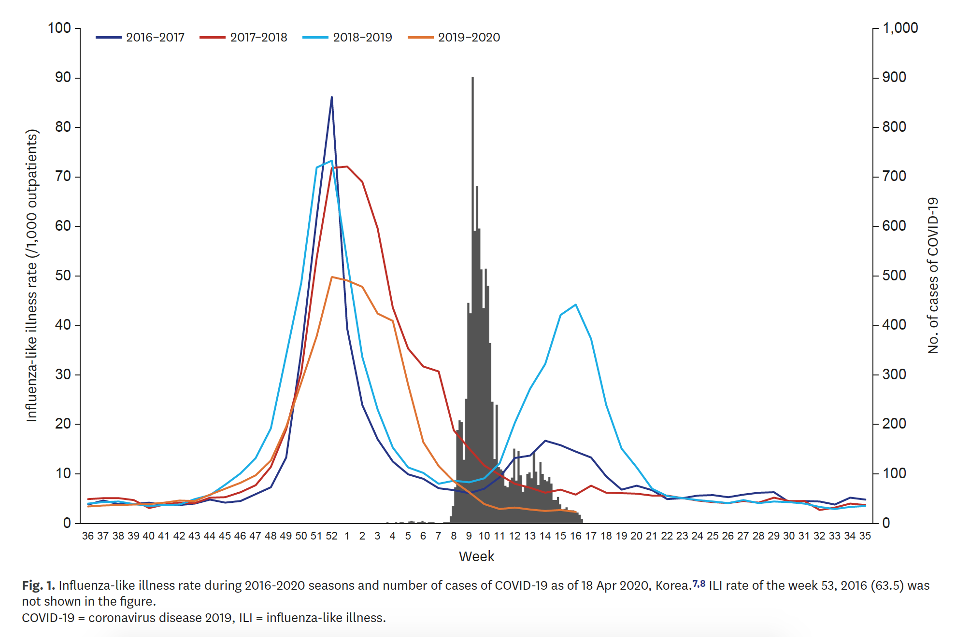
Plots

Slide 21
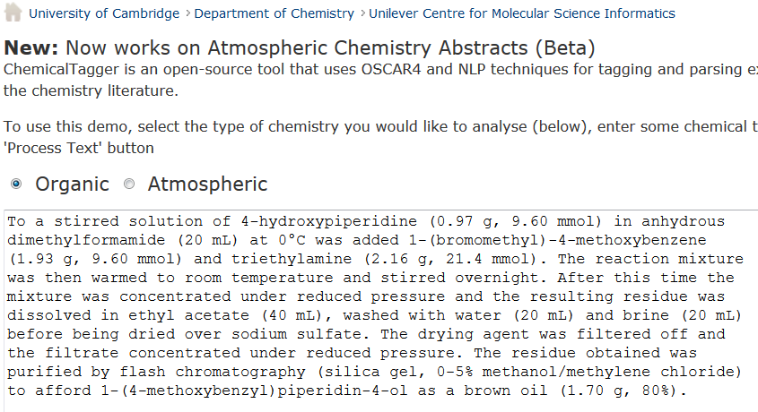
http://chemicaltagger.ch.cam.ac.uk/
Typical
Typical chemical synthesis

Slide 22
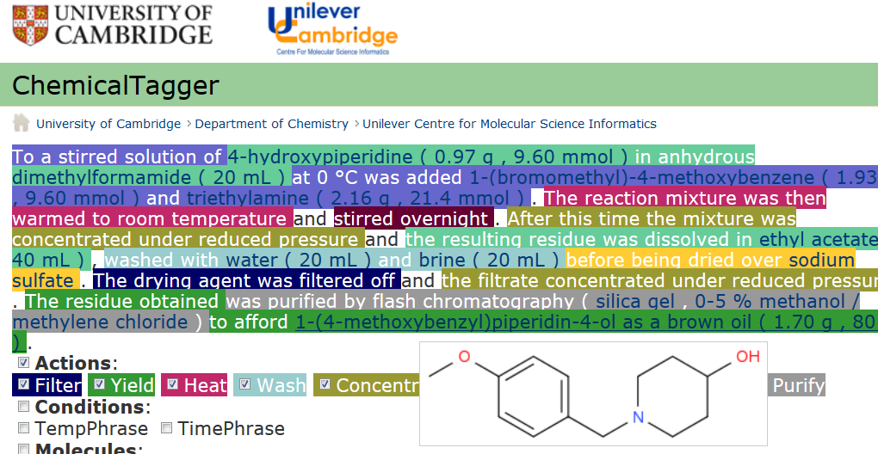
Automatic semantic markup of chemistry
Could be used for analytical, crystallization, etc.

Slide 23
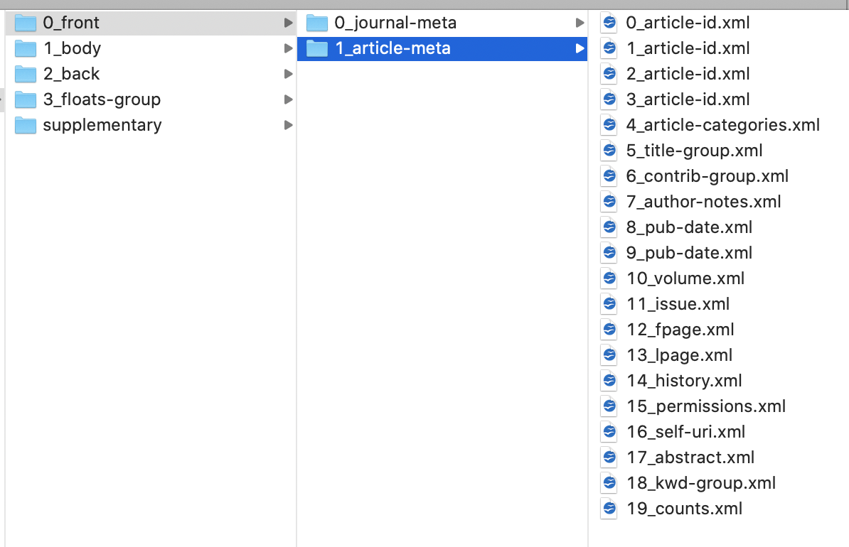
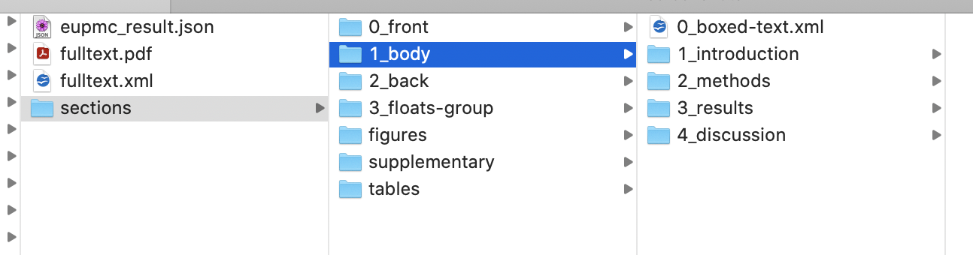
Document structure
Automatically extracted
from JATS-XML by
ami-section

Slide 24
Linked Open Data
things and relations named as http://....… pointing to useful resources
Tim Berners-Lee (2009)
http://wikidata.org/Q42
http://wikidata.org/Q...
http://wikidata.org/P31
https://en.wikipedia.org/wiki/Linked_data#Linked_open_data

Slide 25
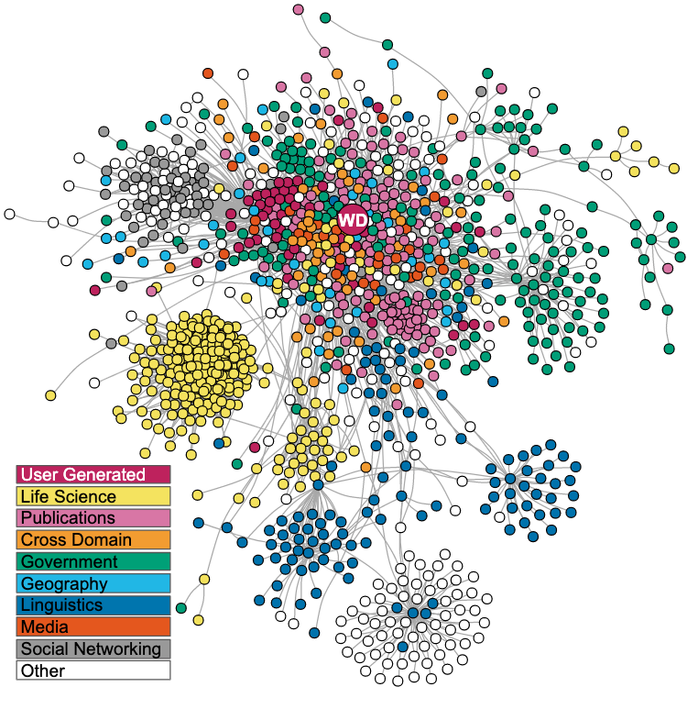
Wikidata Linked Open Data (LOD)
https://en.wikipedia.org/wiki/Linked_data#/media/File:Lod-cloud_2020-08-20.svg

Slide 26
https://elifesciences.org/articles/52614
… Wikidata knowledge graph is based on the automated imports of large structured databases via Wikidata bots,
… community-editing model, it harnesses the distributed efforts of a worldwide community of contributors,

Slide 27
pharmaceutical
taxon
therapeutic
gene
disease
pathway
family
pharmacology
Wikidata biomedical entities and relations
medication
protein
anatomy
compound
https://elifesciences.org/articles/52614
Andra Waagmeester + 25 et al

Slide 28
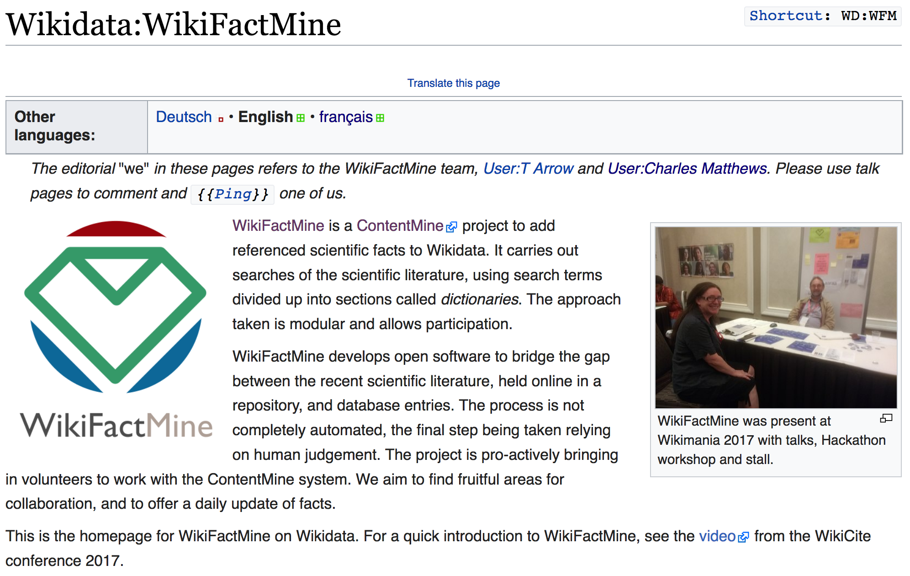

7 million articles, over 200 dictionaries
https://www.wikidata.org/wiki/Wikidata:WikiFactMine
ContentMine thanks the WikimediaFoundation for support

Slide 29
Shweata Hegde and Ambreen Hamadani present the #openVirus project

Slide 30
Images
Extraction of features
Extraction of data

Slide 31
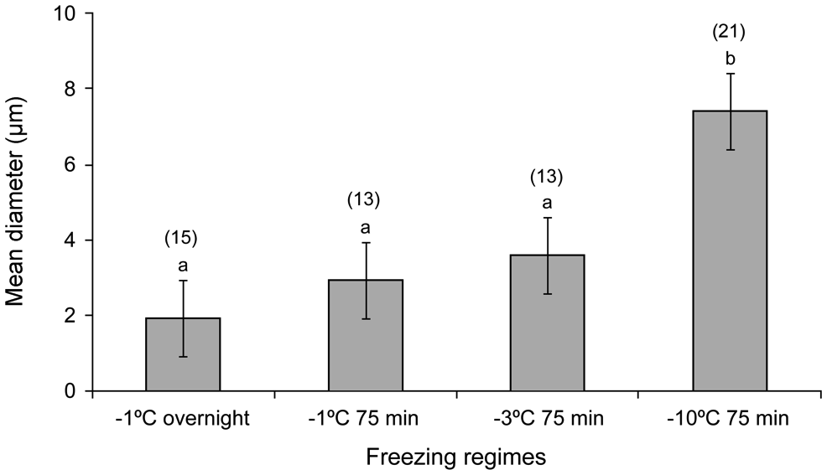
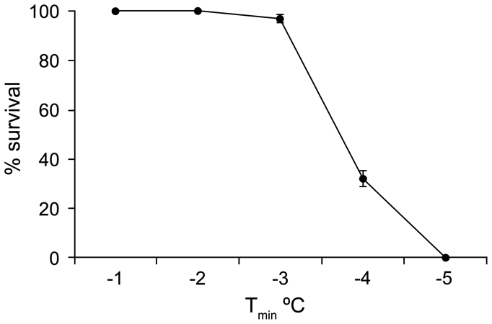
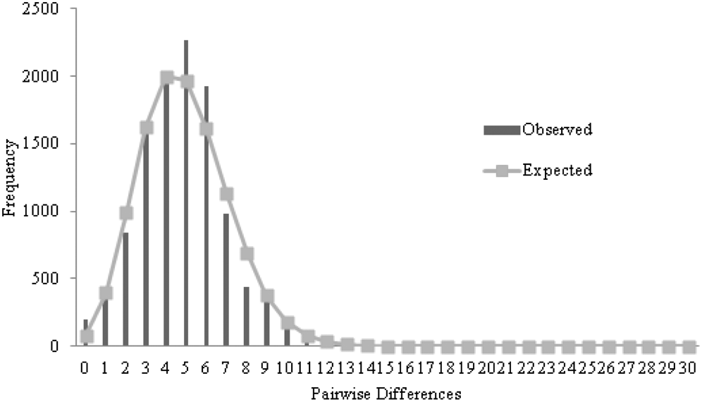
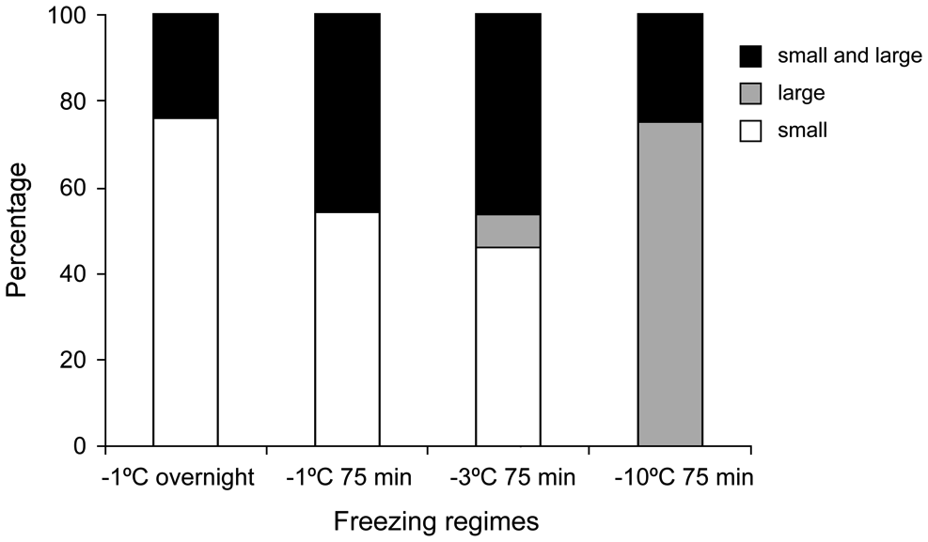
Examples of plots

Slide 32
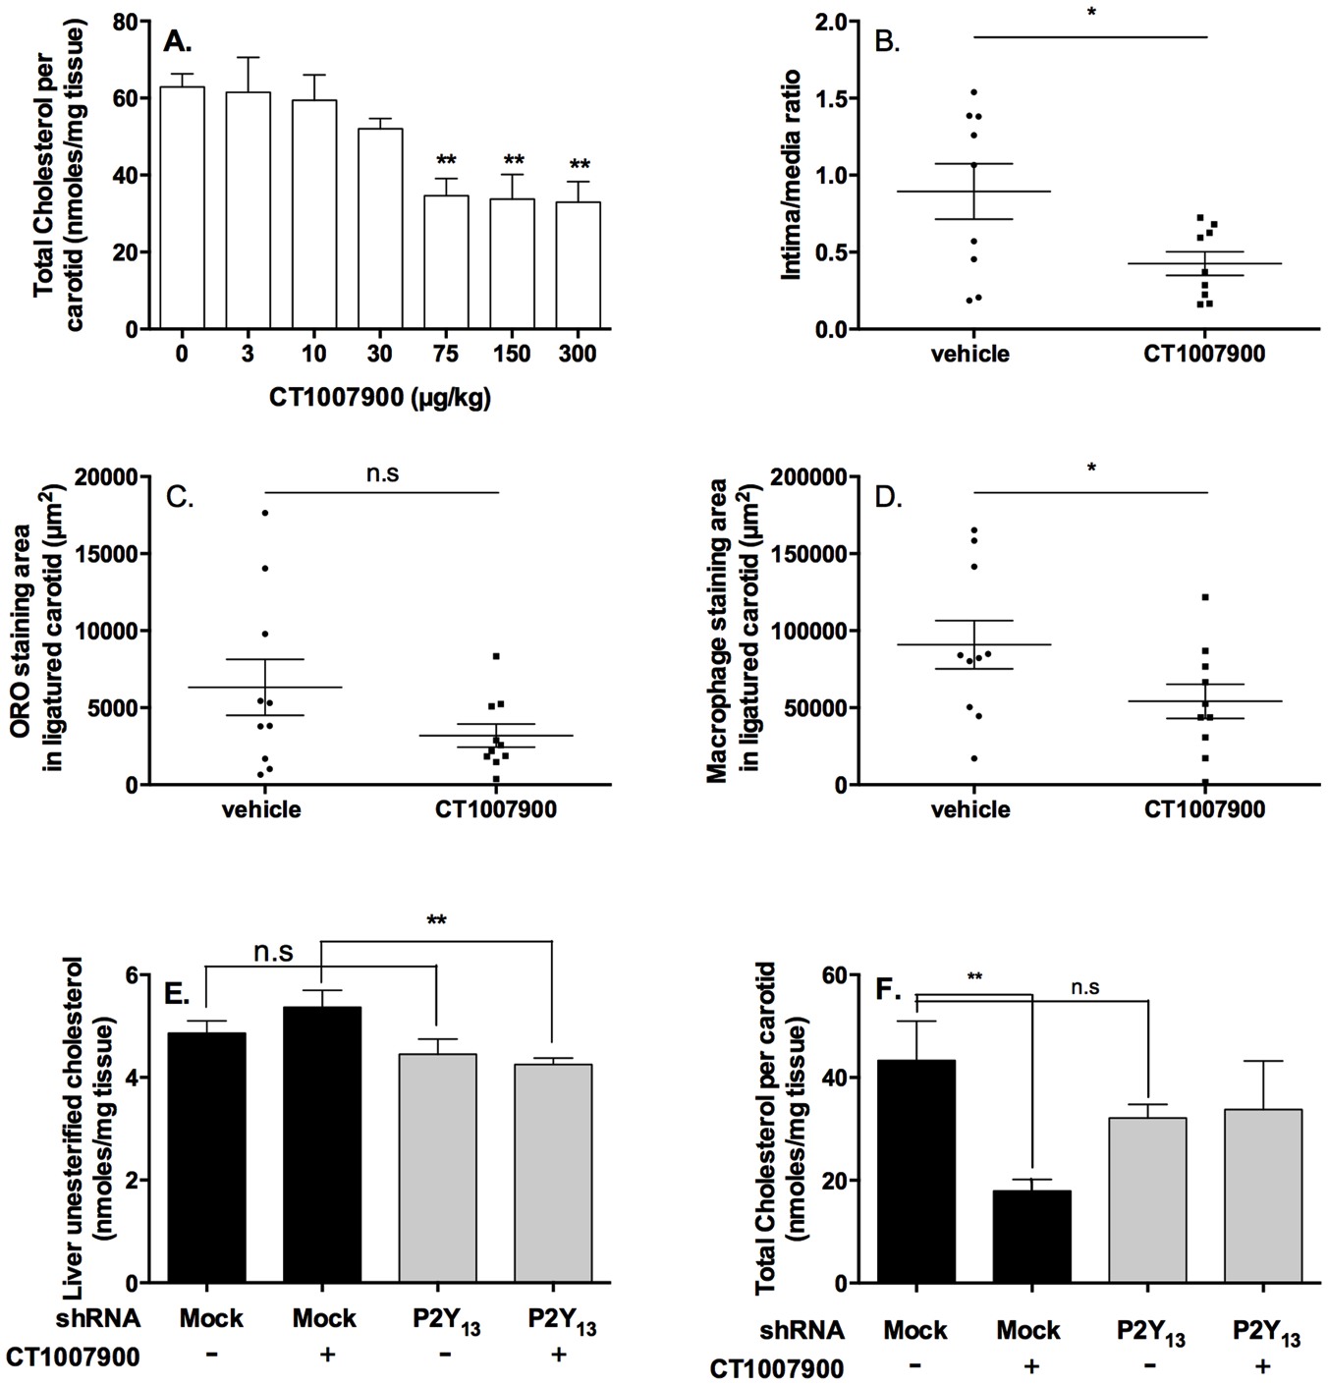
Multisegment diagram

Slide 33
Multisegment diagram
Semantic
labels
Superpixel
Bounding box
Whitespace
“corridors”

Slide 34
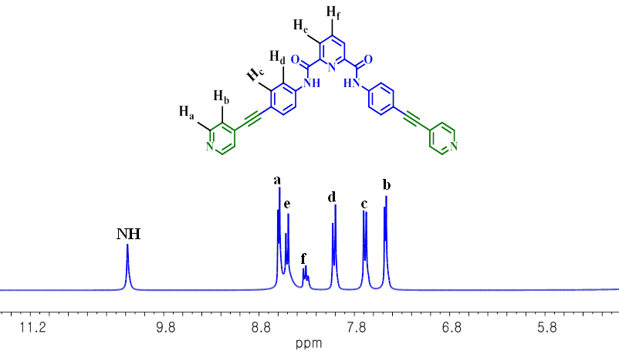

Slide 35
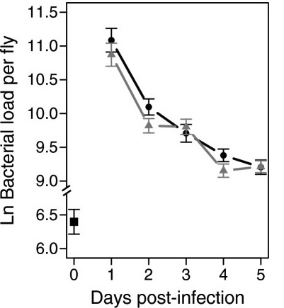
Bitmap Image and Tesseract OCR
11.5
11.0
10.5
10.0
9.5
9.0
6.5
6.0
0 1 2 3 4 5
Ln Bacterial load per fly
Days post—infection

Slide 36
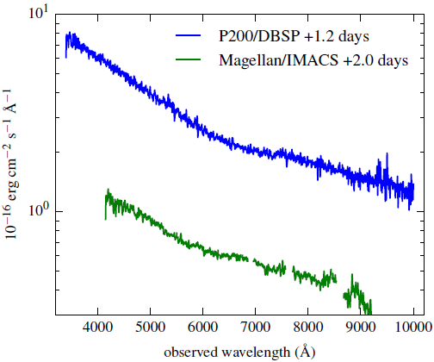
TITLES
VECTOR PDF
DATA!!
2000+ points
UNITS
TICKS
SCALE
QUANTITY

Slide 37
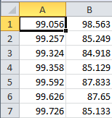
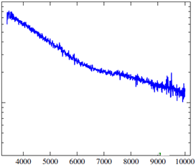
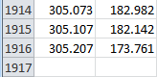
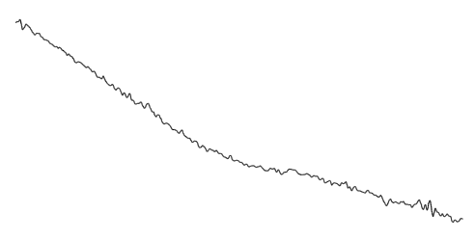

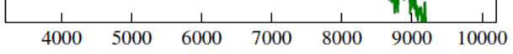
Dumb PDF
Automatic
extraction
CSV
Smoothing Gaussian Filter
Semantic
Spectrum
2nd Derivative

Slide 38
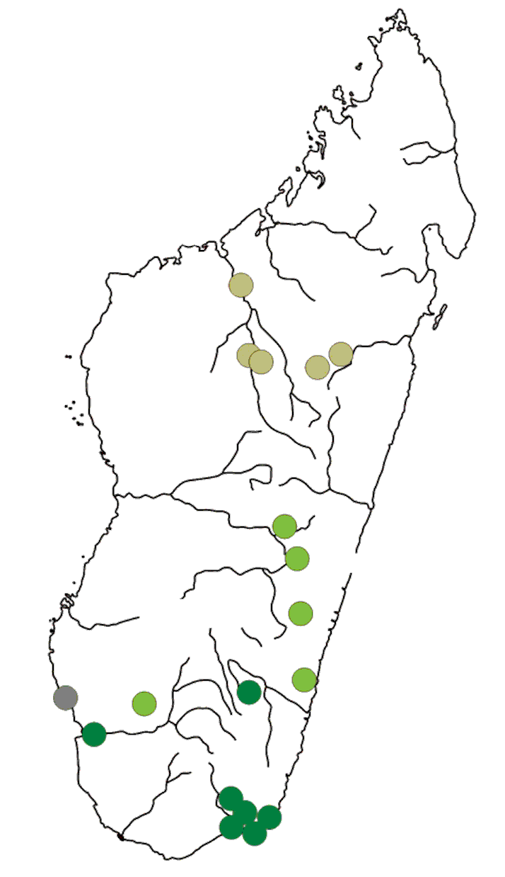

Posterisation
Extracted since unique posterized colour

Slide 39
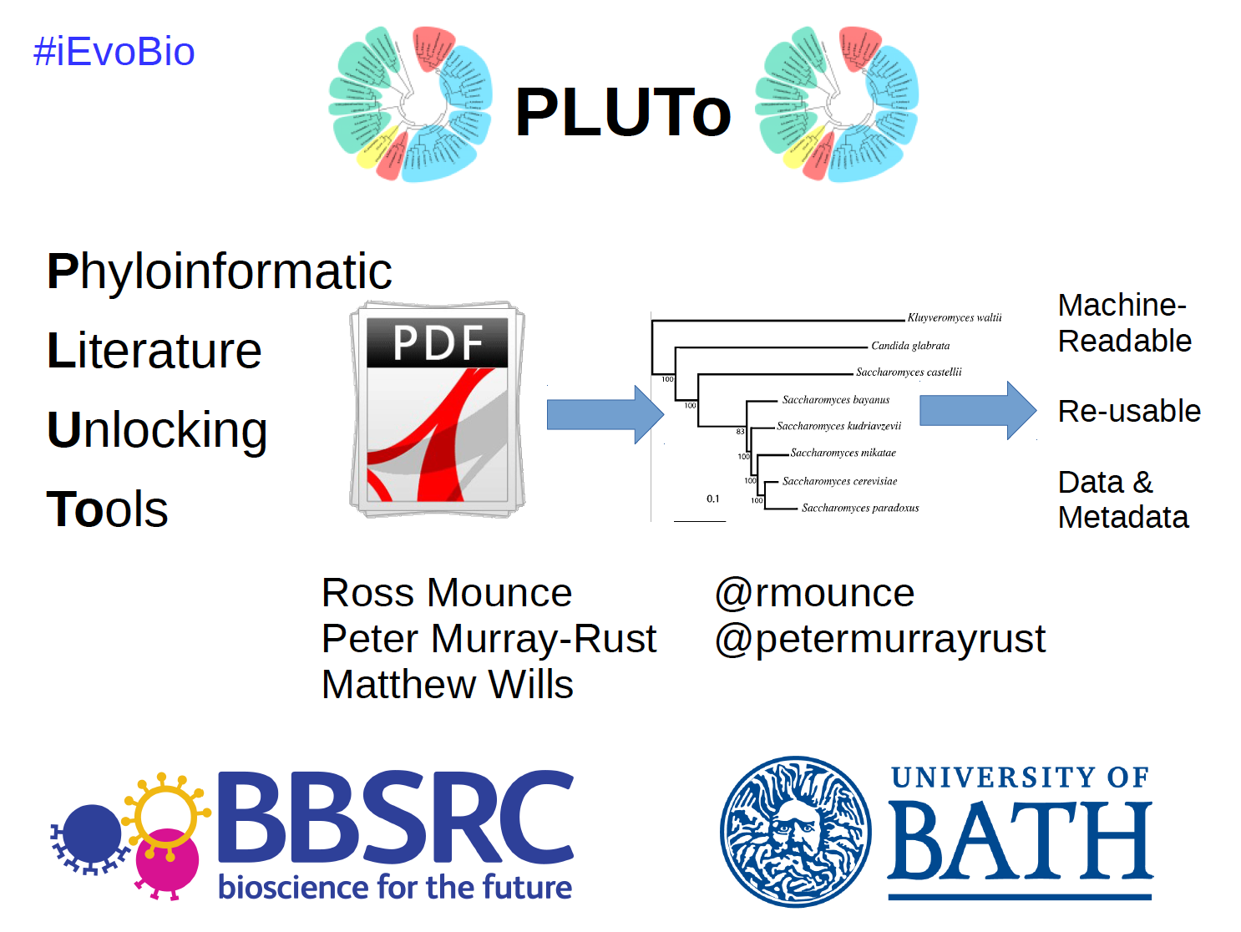
http://www.slideshare.net/rossmounce/the-pluto-project-ievobio-2014

Slide 40
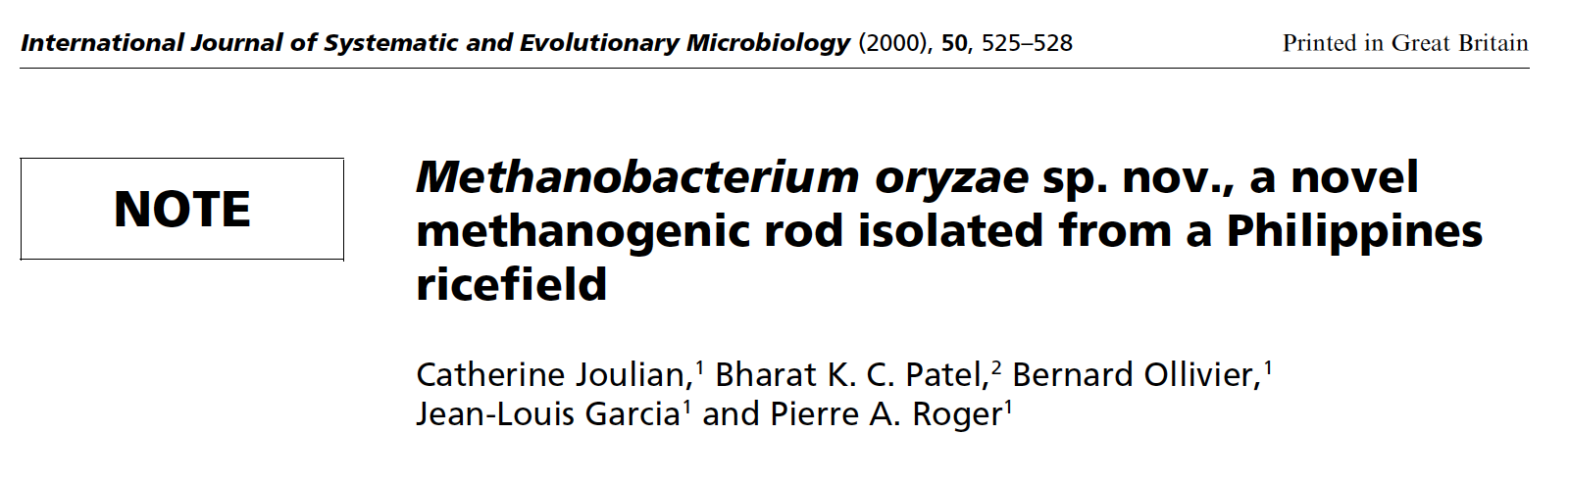
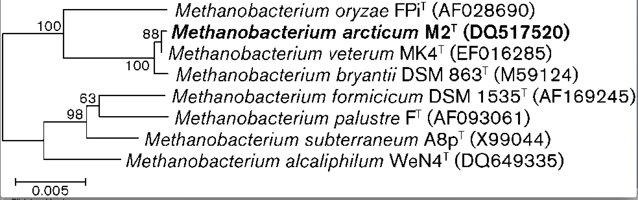
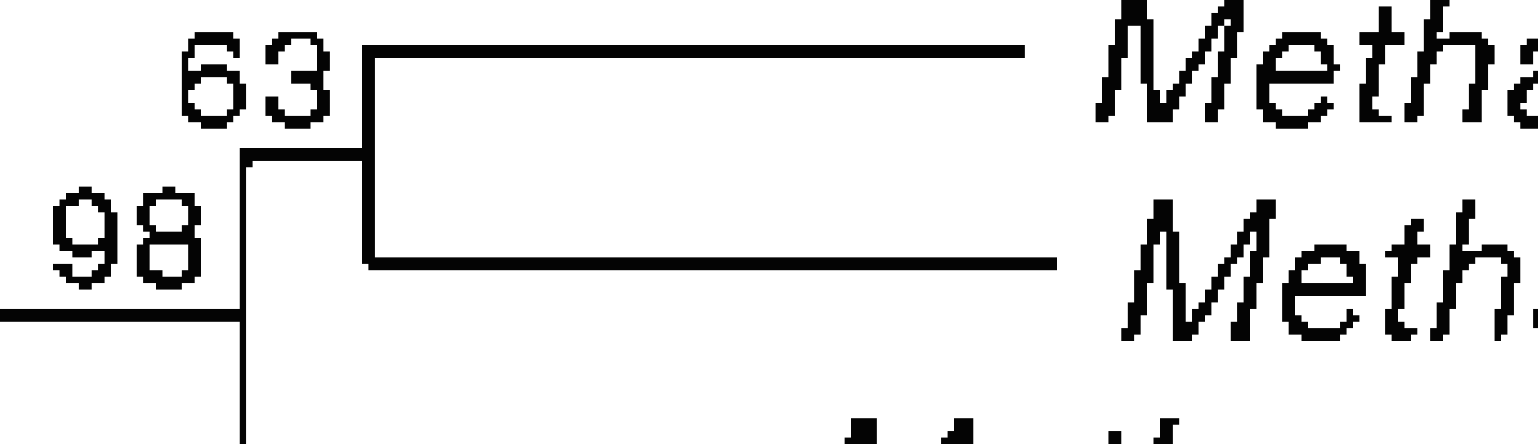
NEW Bacteria must have a phylogenetic tree
Length
_________
Binomial Name
Culture/Strain
GENBANK ID
Weight
Evolution
Rate
Note Jaggy and
broken pixels

Slide 41
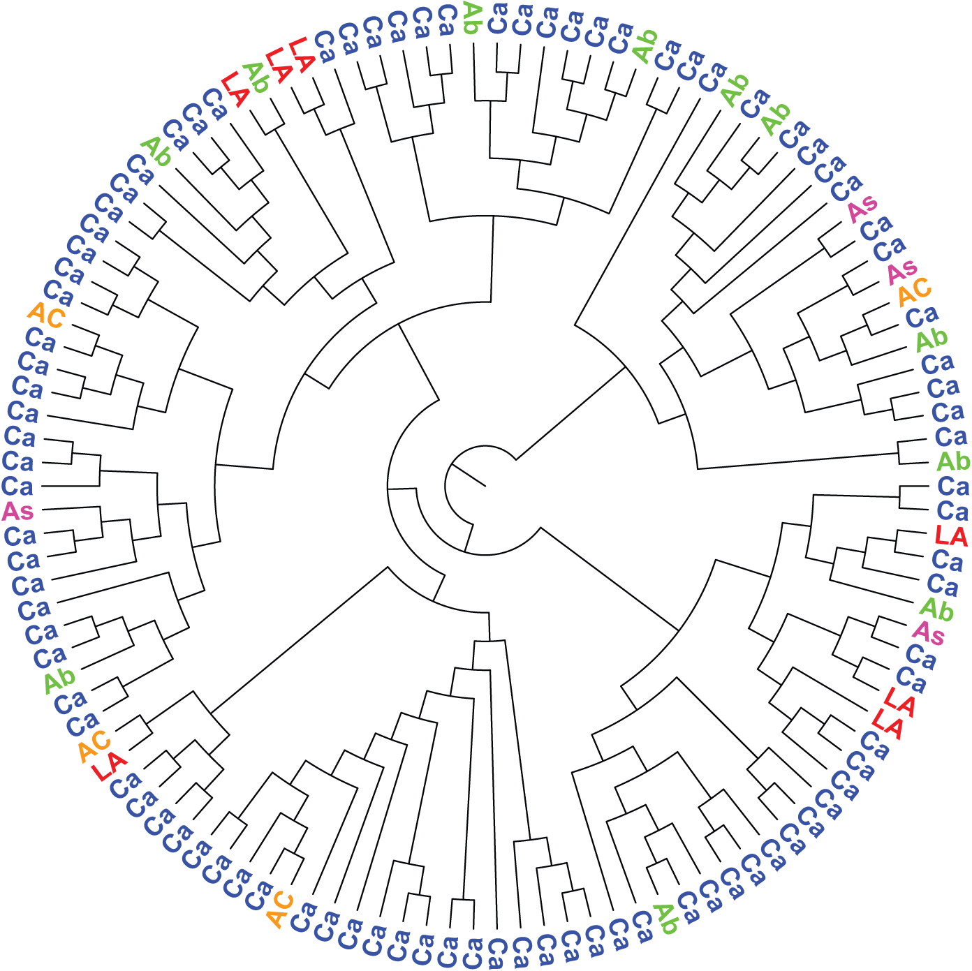
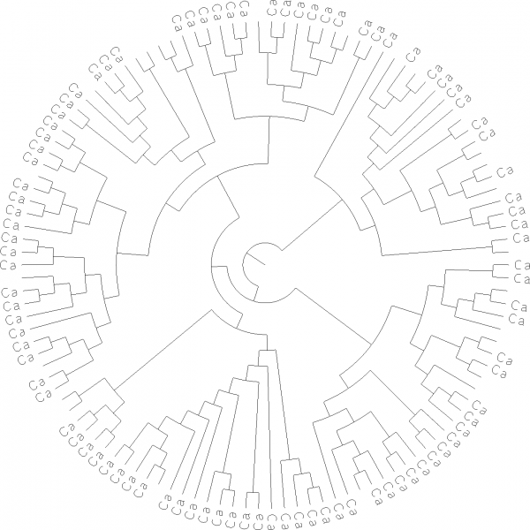
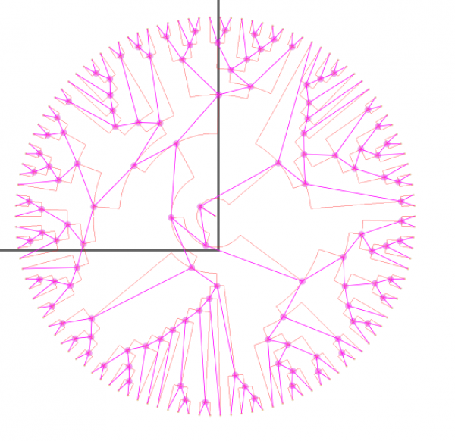
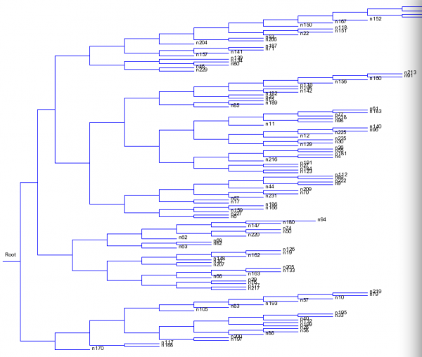
Thinning
Topology
https://blogs.ch.cam.ac.uk/pmr/2014/06/25/content-mining-we-can-now-mine-images-of-phylogenetic-trees-and-more/ for story of extraction
Serialization
Newick

Slide 42
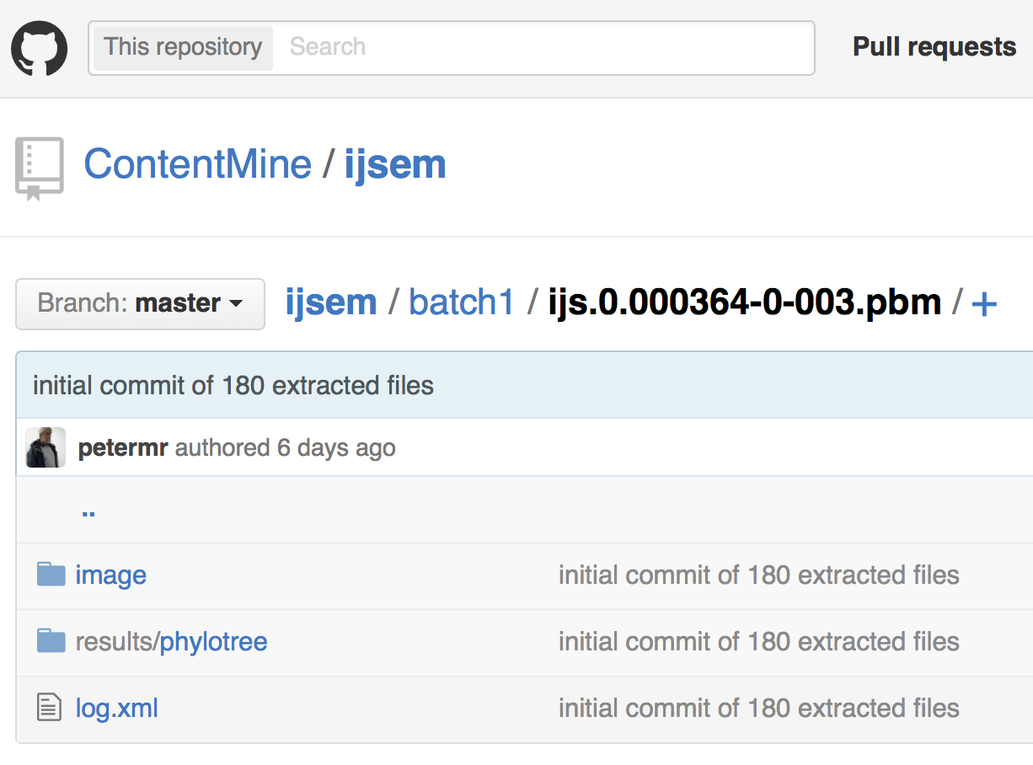
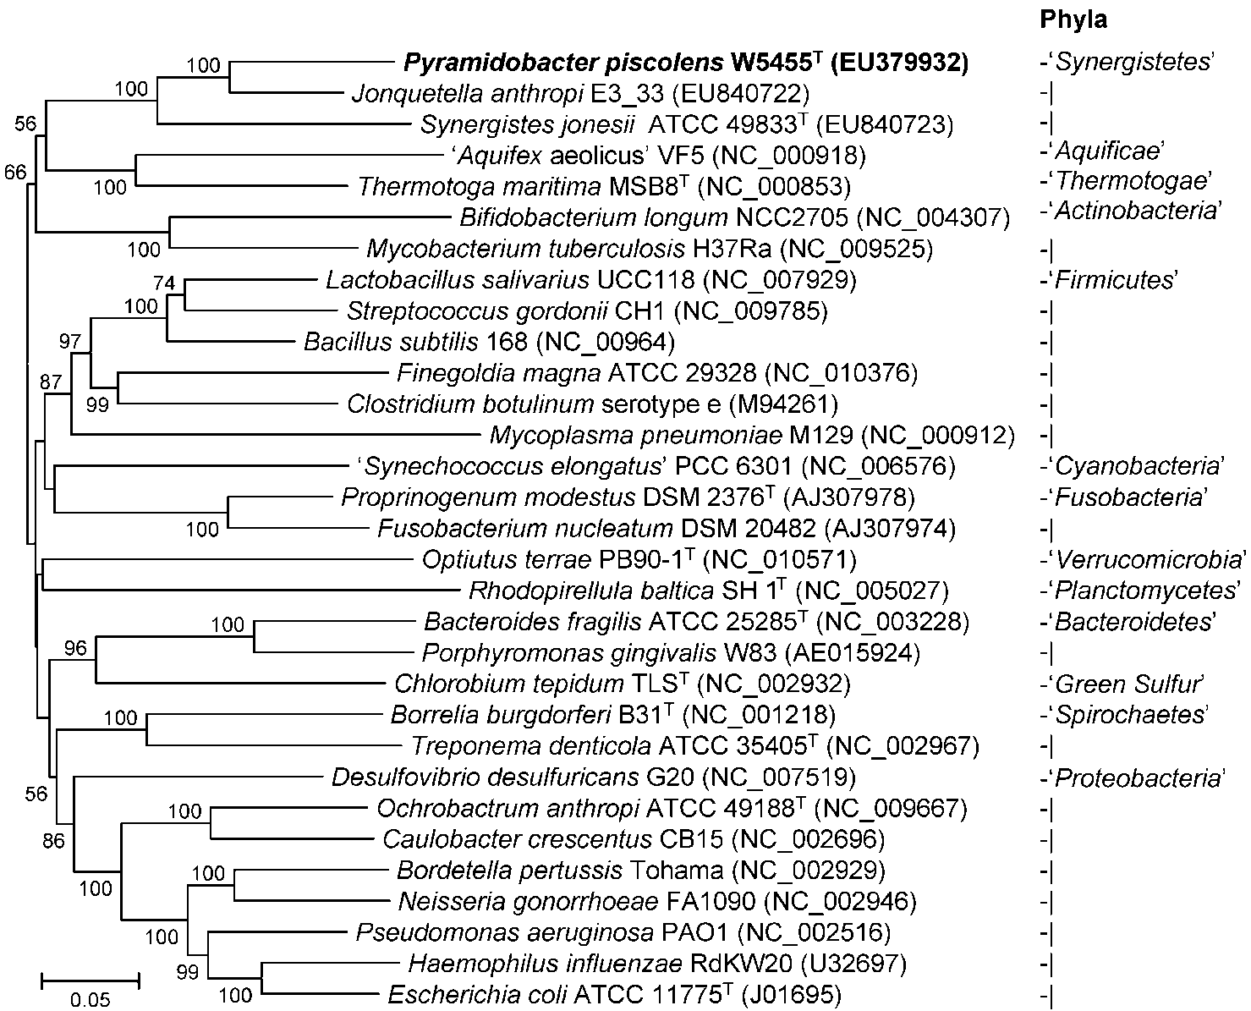
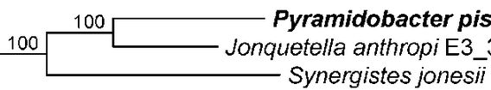

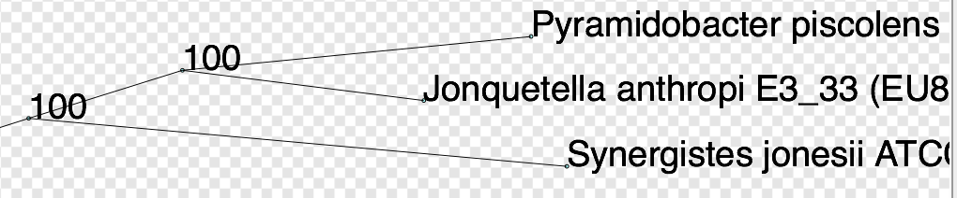
OCR (Tesseract)
Norma (imageanalysis)
(((((Pyramidobacter_piscolens:195,Jonquetella_anthropi:135):86,Synergistes_jonesii:301):131,Thermotoga_maritime:357):12,(Mycobacterium_tuberculosis:223,Bifidobacterium_longum:333):158):10,((Optiutus_terrae:441,(((Borrelia_burgdorferi:…202):91):22):32,(Proprinogenum_modestus:124,Fusobacterium_nucleatum:167):217):11):9);
Semantic re-usable/computable output (ca 4 secs/image)

Slide 43
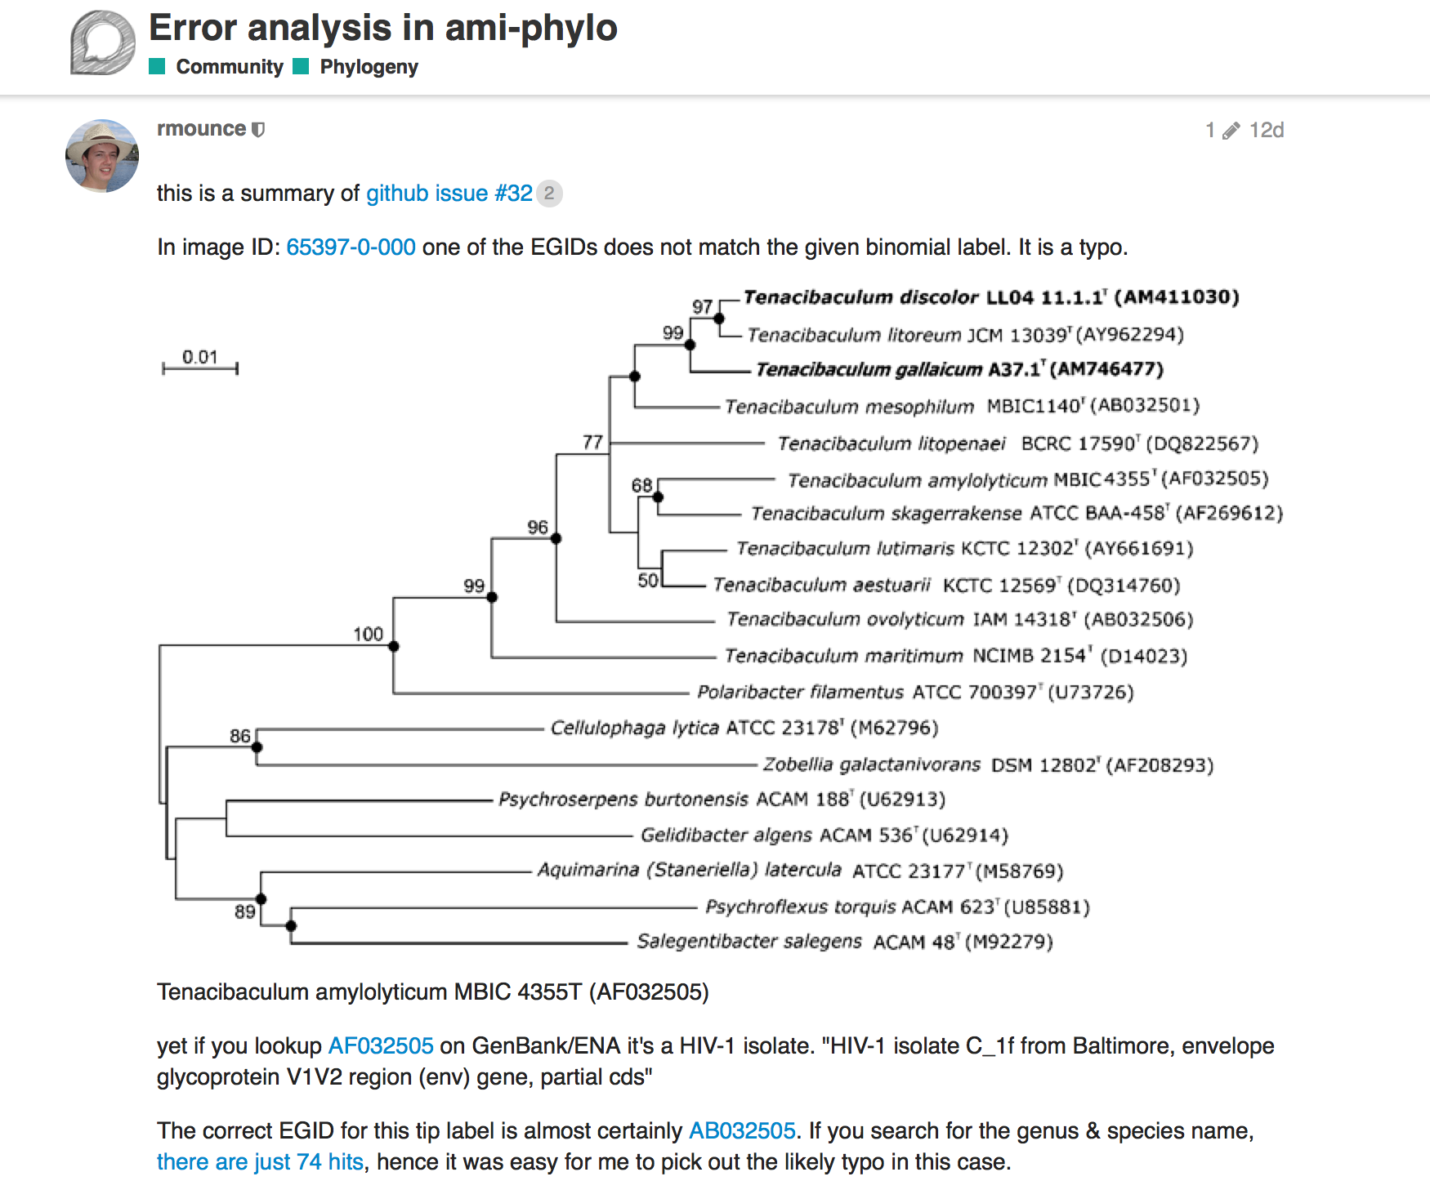
Copyright, Open Access, and Human Rights
March 13, 2015 Kevin Smith, J.D. 2 Comments
The United Nations Human Rights Council … a report from Farida Shaheed, who is a “Special Rapporteur” in the area of “cultural rights.”
… its frank recognition that intellectual property laws are in tension with the fundamental human right of access to science and culture … WIPO is charged, whether effectively or not, to find ways to facilitate open access to science and culture …
this is not just a “what’s best for academia and for my interests” issue, but a true human rights issue. Ms. Shaheed’s report makes this case in a concise and compelling way … - See more at: http://blogs.library.duke.edu/scholcomm/2015/03/13/copyright-open-access-and-human-rights/#sthash.6CQiMoiV.dpuf

Slide 44


Supertree for 924 species
Tree

Slide 45

Supertree created from 4300 papers

Slide 46


Published Monday!

Slide 47


C) What’s the problem with this spectrum?
Original thanks to ChemBark
Org. Lett., 2011, 13 (15), pp 4084–4087
Notes:
ChemBark

Slide 48

After AMI2 processing…..
… AMI2 has detected a square

Slide 49


Slide 50
Ethics and Politics

Slide 51

Elsevier stopped me doing my research
Chris Hartgerink
@Senficon (Julia Reda) :Text & Data mining in times of #copyright maximalism:
"Elsevier stopped me doing my research" http://onsnetwork.org/chartgerink/2015/11/16/elsevier-stopped-me-doing-my-research/ … #opencon #TDM

Slide 52
The Publisher-Academic complex[1]
$$, MS
review
Taxpayer
$$
$$
Publishers
Academia
Student
Glory+?
in-kind
Infrastructure
Researcher
“The scholarly poor”
[1] The Military-Industrial-Academic complex (1961)
(Dwight D Eisenhower, US President)

Slide 53

https://www.youtube.com/watch?v=zxKPsueoFBo

Slide 54
BENEFITS OF CONTENT MINING
Hague Declaration 2015
Addressing grand challenges such as climate change and global epidemics
Improving population health, wealth and development
Creating new jobs and employment
Exponentially increasing the speed and progress of science through new insights and greater efficiency of research
Increasing transparency of governments and their actions
Fostering innovation and collaboration and boosting the impact of open science
Creating tools for education and research
Providing new and richer cultural insights
Speeding economic and social development in all parts of the globe

Slide 55
thanks
India interns
Ambreen Hamadani Anugrah S. R. Charles Zeyang Li Kareena Singh Lakshmi Devi Priya Pruthiv Rajan Karunakaran Shweata N. Hegde Sana Saifi Vaishali Arora Vanisha Arora Dheeraj Kumar Jitu Ram Bhargav Om Prakash Mehra Pooja Pareek Simranleen Singh Urja Biswas Aishwarya Dharan Ayush Garg Mukul Bhambri Padmini Rai Ebhoimen Israel
Gitanjali Yadav (Delhi/Cambridge)
Wikimedia (Brazil) Redalyc (Mexico)

Slide 56
BENEFITS OF CONTENT MINING
Hague Declaration 2015
Addressing grand challenges such as climate change and global epidemics
Improving population health, wealth and development
Creating new jobs and employment
Exponentially increasing the speed and progress of science through new insights and greater efficiency of research
Increasing transparency of governments and their actions
Fostering innovation and collaboration and boosting the impact of open science
Creating tools for education and research
Providing new and richer cultural insights
Speeding economic and social development in all parts of the globe

